Slide 1
How AI Works & Why You Are Important (in 60 minutes)
Lisa Yan
(with slides from Chris Piech)

Slide 2
Where is my robot?

Slide 3
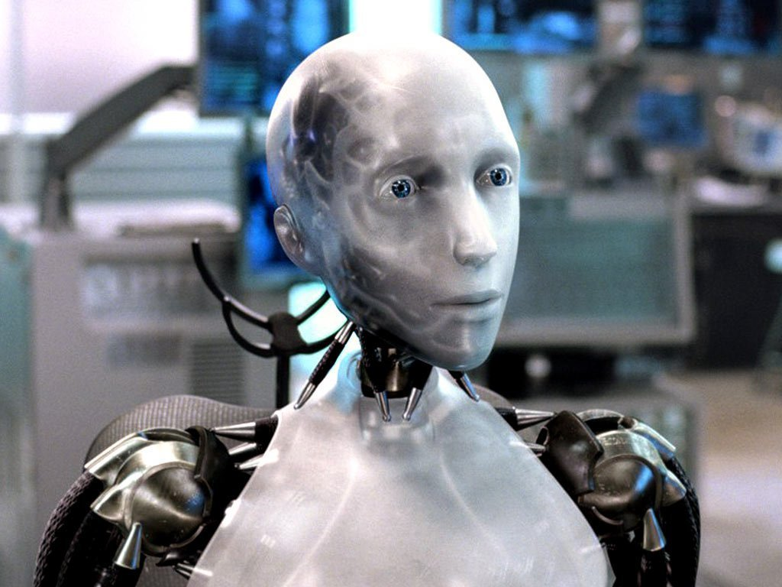
Sci-Fi Has Promised Me Robots

Slide 4
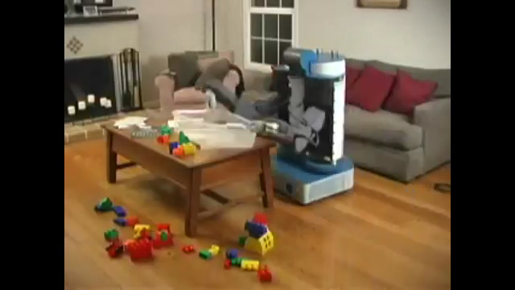
House Cleaning Robot
Notes:
2008 wyrobek, willow garage
Towards a Personal Robotics Development Platform: Rationale and Design of an Intrinsically Safe Personal Robot Keenan A. Wyrobek, Eric H. Berger, H.F. Machiel Van der Loos, Member, IEEE, and J. Kenneth Salisbury, Member, IEEE

Slide 5
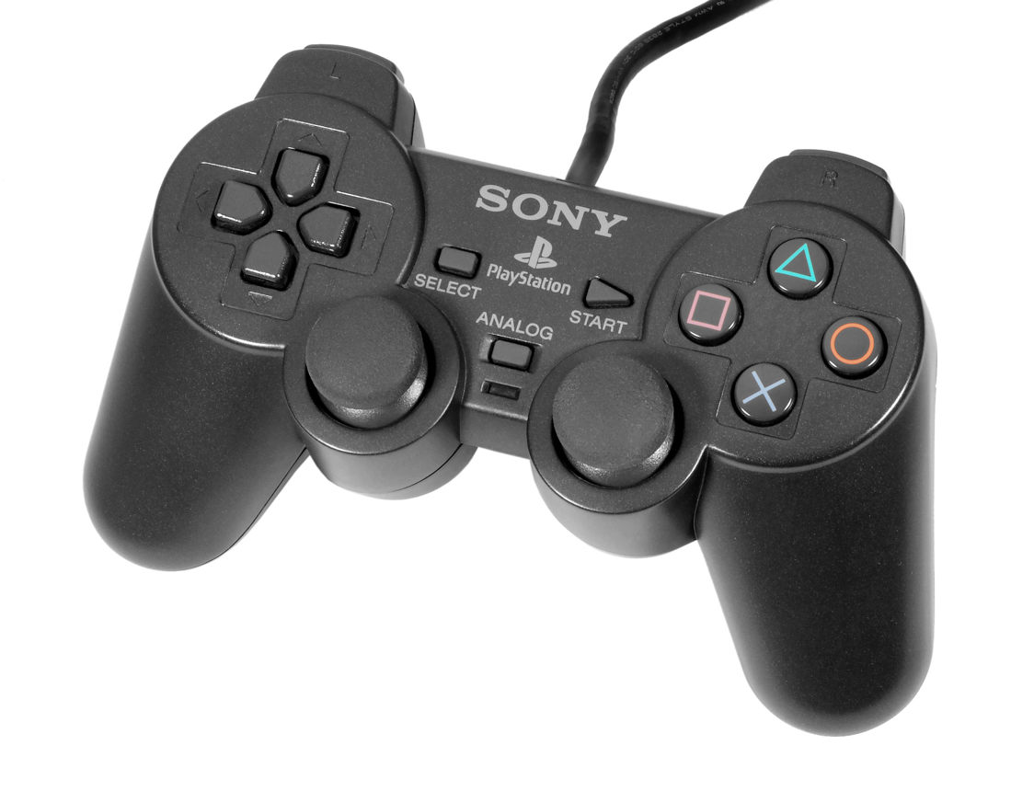
House Cleaning Robot

Slide 6
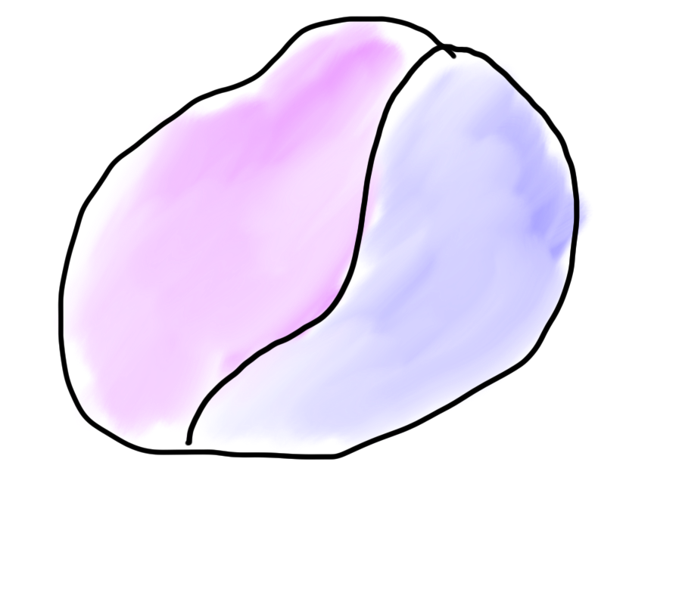

Robots?
Mind
Body
🤔

Slide 7
What is AI?

Slide 8
[suspense]

Slide 9
Computer
programs
AI: The study and design of intelligent agents.
Better than
chance
As well as
humans

Slide 10
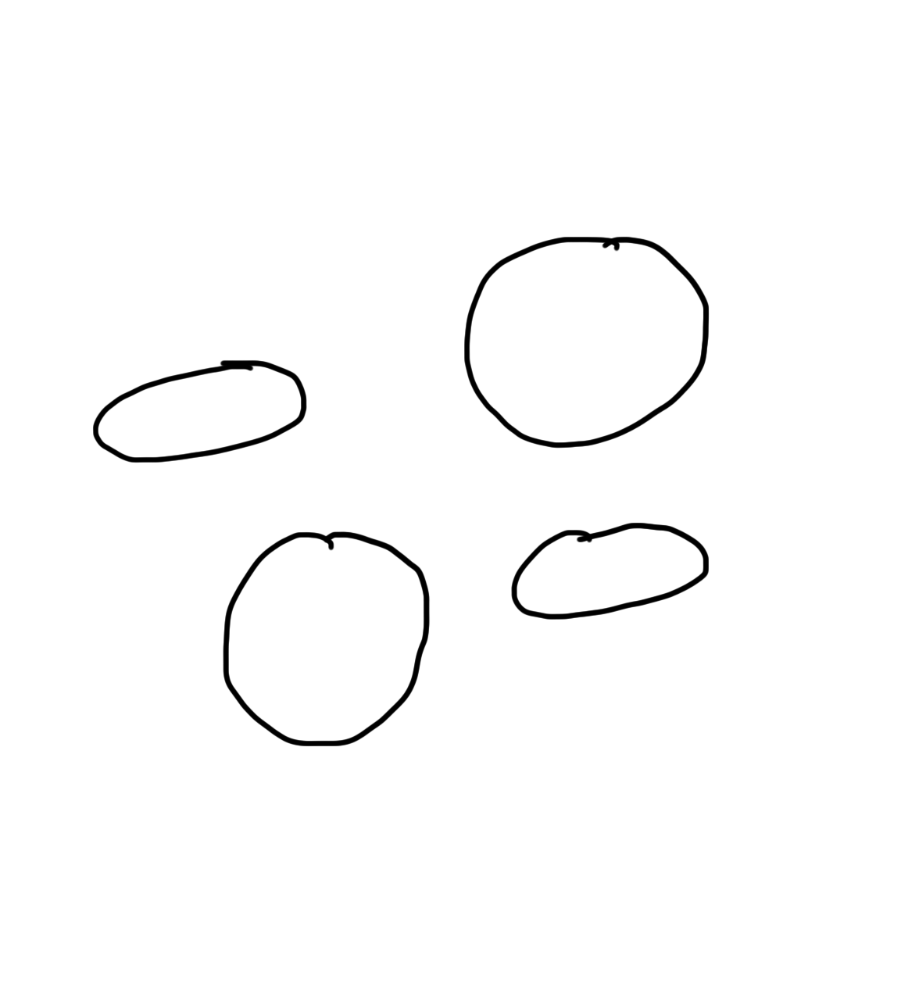
Narrow Intelligence
Translate
Turkish
Play Chess
Play Breakout
Drive a
Car

Slide 11
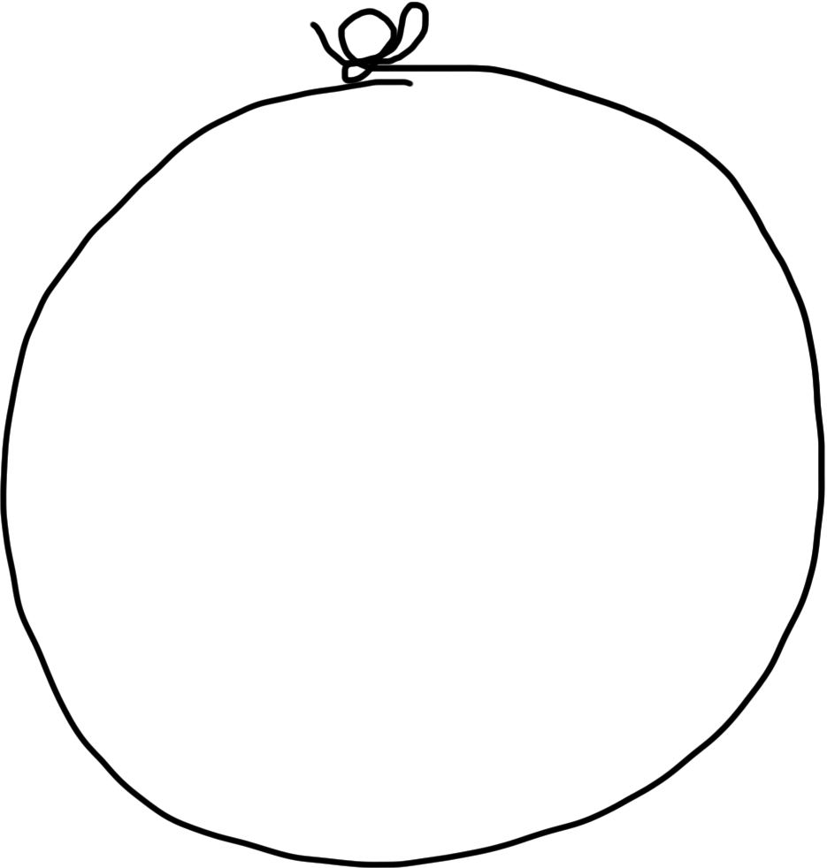
General Intelligence
Translate
Turkish
Play Chess
Play Breakout
Drive a
Car

Slide 12
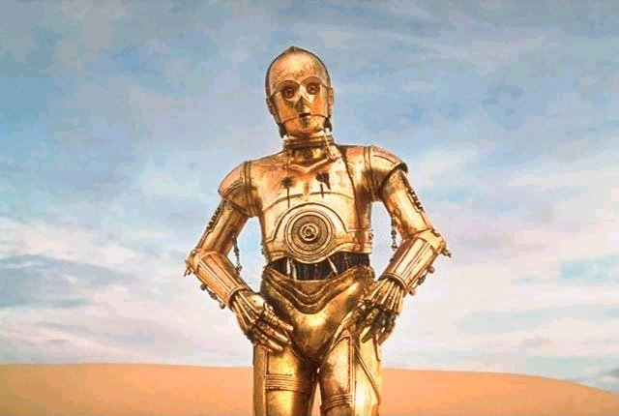
Brief History

Slide 13
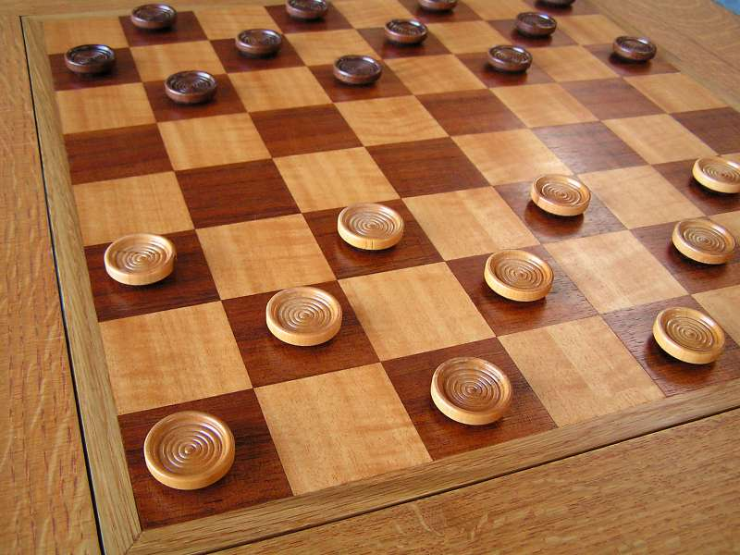
Early Optimism 1950s
1952
Notes:
Checkers, IBM, a person named Arthur Samuel

Slide 14
Early Optimism (1950s)
“Machines will be capable, within twenty years, of doing any work a man can do.”
–Herbert Simon, 1952

Slide 15
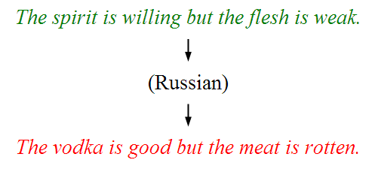
Underwhelming Results (1950s–1980s)
The world is too complex!

Slide 16





Modern Game of AI
2014

Slide 17

Told Speech Was 30 Years Out
Almost perfect…
Notes:
https://twitter.com/kid_chrissy/status/1082472189725687808

Slide 18
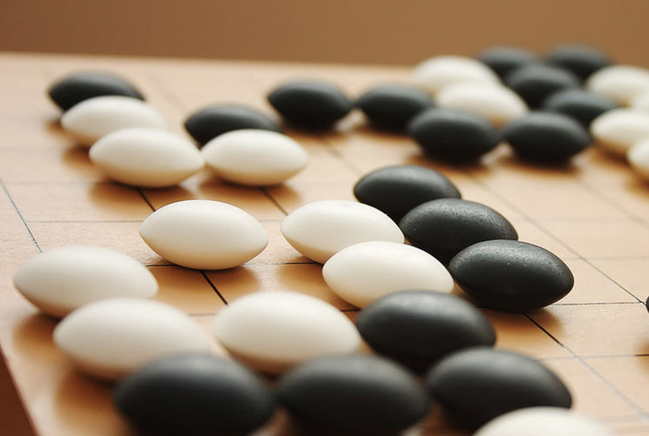
The Last Remaining Board Game
Notes:
AlphaGo, 2016 (Lee Sedol, Korea) Google DeepMind

Slide 19
Computers Making Art

Slide 20
Self-driving Cars
Notes:
2016 google car..

Slide 21
What is going on?

Slide 22
[more suspense]

Slide 23
Story of Modern AI:
Focus on one problem

Slide 24
Make a Harry Potter Sorting Hat

Slide 25

Classification
Logistic Regression is like the Harry Pottery Sorting Hat
That is a picture
of a one

Slide 26

Classification
Logistic Regression is like the Harry Pottery Sorting Hat
That is a picture
of a zero

Slide 27

Classification
That is a picture
of an zero
* It doesn’t have to be correct all of the time

Slide 28
Can you do it?

Slide 29

What number is this?

Slide 30

What number is this?

Slide 31

How about now?
What a computer sees
0 | 0 | 1 | 0 | 1 | 0 | 1 | 0 | 0 | 0 | 1 | 1 | 1 | 0 | 1
1 | 0 | 0 | 1 | 0 | 1 | 1 | 1 | 0 | 1 | 0 | 0 | 0 | 0 | 0
1 | 1 | 1 | 0 | 1 | 0 | 0 | 1 | 1 | 0 | 0 | 1 | 0 | 1 | 0
1 | 1 | 1 | 1 | 1 | 0 | 0 | 0 | 0 | 0 | 1 | 1 | 0 | 1 | 1
0 | 0 | 0 | 1 | 1 | 0 | 0 | 1 | 0 | 0 | 0 | 1 | 1 | 1 | 0
1 | 0 | 0 | 1 | 1 | 0 | 0 | 0 | 1 | 0 | 1 | 1 | 1 | 1 | 0
1 | 1 | 0 | 1 | 1 | 0 | 0 | 1 | 1 | 0 | 1 | 1 | 1 | 0 | 0
1 | 0 | 1 | 0 | 0 | 1 | 0 | 0 | 1 | 0 | 0 | 1 | 1 | 1 | 1
0 | 0 | 0 | 0 | 1 | 0 | 1 | 0 | 1 | 1 | 0 | 0 | 1 | 1 | 1
0 | 1 | 1 | 0 | 0 | 0 | 0 | 0 | 1 | 1 | 1 | 1 | 1 | 1 | 0
0 | 0 | 1 | 0 | 1 | 1 | 1 | 0 | 0 | 0 | 1 | 0 | 0 | 0 | 0
0 | 1 | 1 | 1 | 0 | 1 | 0 | 0 | 1 | 0 | 0 | 0 | 0 | 0 | 1
1 | 1 | 0 | 0 | 0 | 0 | 0 | 0 | 0 | 0 | 1 | 0 | 0 | 1 | 1
0 | 0 | 0 | 0 | 0 | 0 | 0 | 0 | 1 | 1 | 1 | 1 | 0 | 0 | 1
0 | 0 | 1 | 1 | 1 | 0 | 1 | 0 | 1 | 1 | 0 | 0 | 0 | 1 | 0
What a human sees

Slide 32
Why is it easy for Humans?
About 30% of your cortex is used from vision
3% is used to process hearing

Slide 33
Very hard to Program
??
public class HarryHat extends ConsoleProgram {
public void run() {
println("Todo: Write program");
}
}

Slide 34
Perhaps there is an insight?

Slide 35
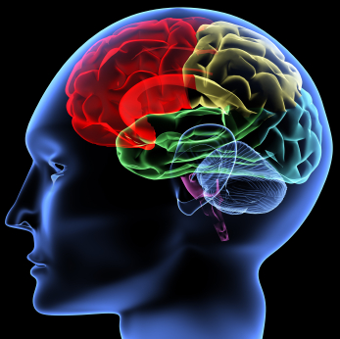
One Algorithm Hypothesis
Much of perception in the brain can be explained with a single learning algorithm.
[Andrew Ng]

Slide 36

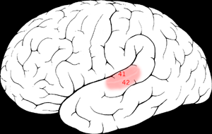

One Algorithm Hypothesis
Auditory Cortex
Auditory cortex learns to see
[Roe et al., 1992]
[Andrew Ng]

Slide 37
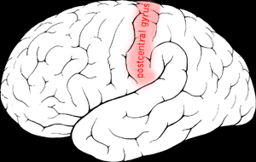

One Algorithm Hypothesis
Somatosensory Cortex
Somatosensory cortex learns to see
[Metin & Frost, 1989]
[Andrew Ng]

Slide 38
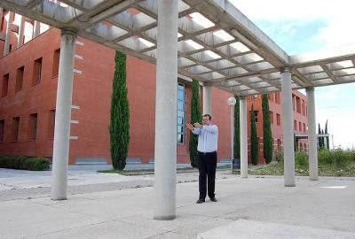
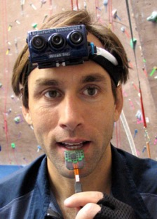
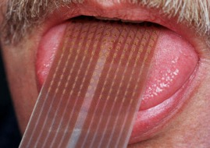
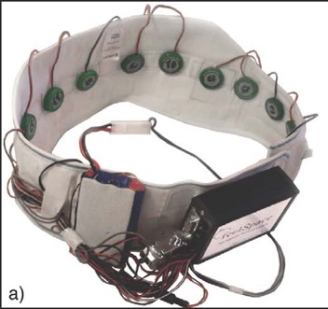
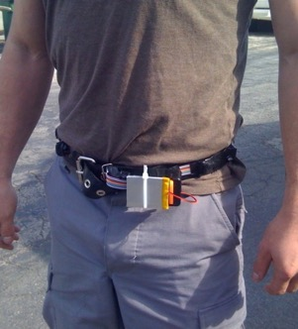
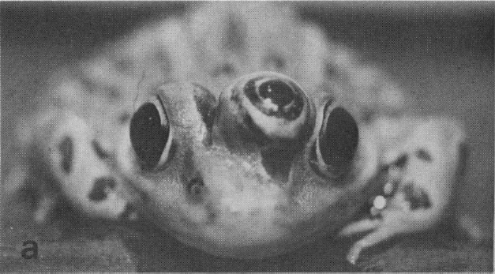
Sensor Representations
Seeing with your tongue
Human echolocation (sonar)
Haptic belt: Direction sense
Implanting a 3rd eye
[BrainPort; Welsh & Blasch, 1997; Nagel et al., 2005; Constantine-Paton & Law, 2009]

Slide 39
Two Great Ideas
Story of Modern AI:
1. Artificial Neurons
2. Learn by Example
Machine Learning

Slide 40
1. Artificial Neurons

Slide 41
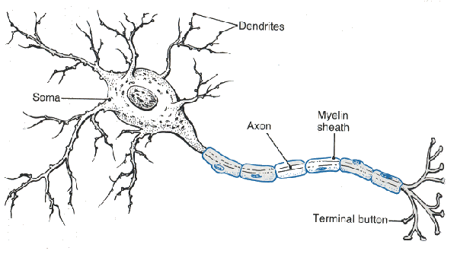
Neuron

Slide 42
Neuron

Slide 43
Neuron

Slide 44
Neuron

Slide 45
Neuron

Slide 46
Some Inputs are More Important

Slide 47
Artificial Neuron

Slide 48

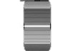


Inputs
+

Slide 49
Inputs
+

Slide 50
Inputs
+

Slide 51
Weights
+

Slide 52
Weights
+

Slide 53
Weights
+

Slide 54
Weighted Sum
+
double weightedSum = 0;
weightedSum += input0 * weight0;
weightedSum += input1 * weight1;
weightedSum += input2 * weight2;
weightedSum += input3 * weight3;

Slide 55
Filter and Output
+

Slide 56
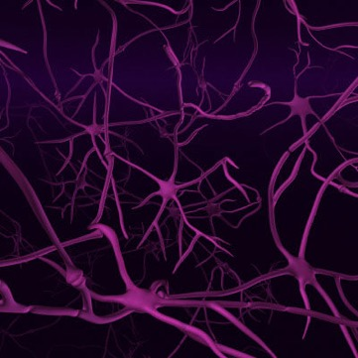
Biological Basis
A neuron
Your brain
(actually, probably someone else’s brain)
???

Slide 57




Put Many Together
+
+
+
+

Slide 58
Put Many Together
Input Neurons
Hidden Neurons
Output Neurons

Slide 59
Making a Prediction
…
Input Neurons
Hidden Neurons
Output Neurons

Slide 60
Making a Prediction
…
Input Neurons
Hidden Neurons
Output Neurons

Slide 61
Making a Prediction
…
Input Neurons
Hidden Neurons
Output Neurons

Slide 62
Making a Prediction
I think that is a picture of a one!
…
Input Neurons
Hidden Neurons
Output Neurons

Slide 63
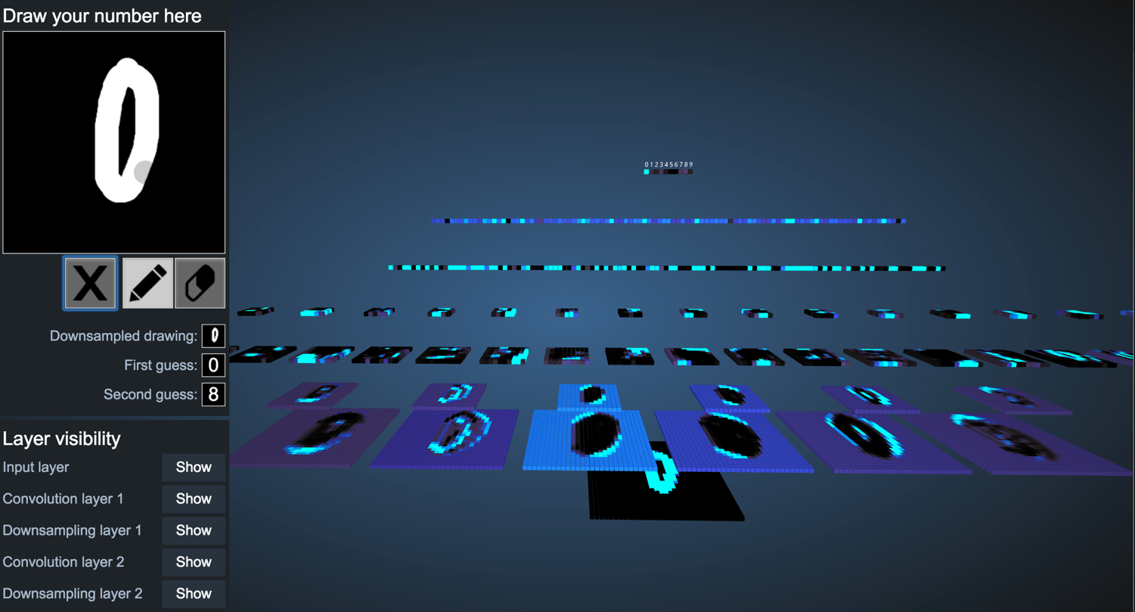
You Can Try It Yourself
http://scs.ryerson.ca/~aharley/vis/conv/

Slide 64
Great Idea: Artificial Neurons

Slide 65
Two Great Ideas
1. Artificial Neurons
2. Learn by Example

Slide 66
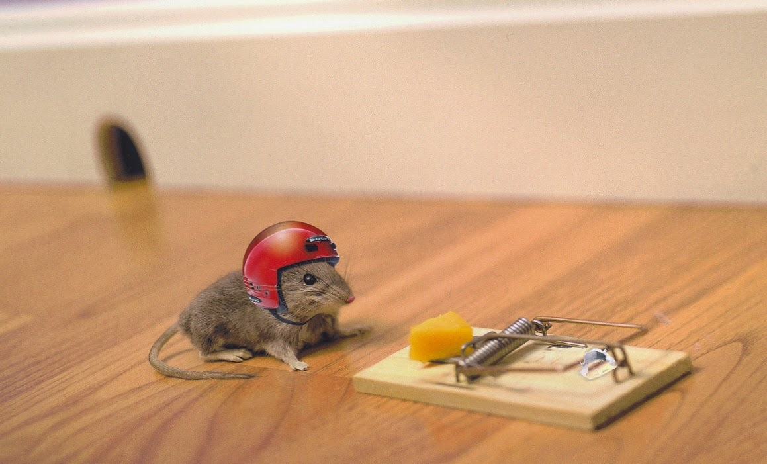
2. Learn From Experience

Slide 67
Neural Networks gets their intelligence from its sliders (aka its weights)

Slide 68
Neural Network
Input Neurons
Hidden Neurons
Output Neurons

Slide 69
Neural Network
+
+
+
+

Slide 70

Learn by Example

Slide 71



+

Slide 72
I think that is a picture of a one!
+
Oh what, it’s a zero??
Ill adjust my sliders so that I do better.

Slide 73
I think that is a picture of a one!
+
Oh what, it’s a zero??
Ill adjust my sliders so that I do better.

Slide 74
+

Slide 75
+

Slide 76
I think that is a picture of a one!
+
Woohoo, I got it right!!

Slide 77

+

Slide 78
I think that is a picture of a zero!
+
Oh what, it’s a one??
I’ll adjust my sliders so that I do better.

Slide 79
I think that is a picture of a zero!
+
Oh what, it’s a one??
I’ll adjust my sliders so that I do better.

Slide 80
Study Hard!

Slide 81
Train on Faces

Slide 82
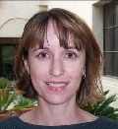
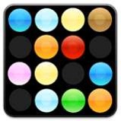
Visualize the Sliders
object models
object parts
(combination
of edges)
Training set: Aligned
images of faces.
edges
pixels
[Honglak Lee]

Slide 83
Woah… that’s like a brain…

Slide 84
True.

Slide 85
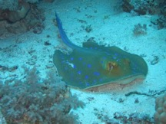
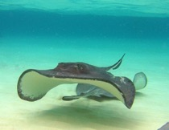

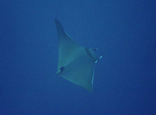


ImageNet Decomposition
…
smoothhound, smoothhound shark, Mustelus mustelus
American smooth dogfish, Mustelus canis
Florida smoothhound, Mustelus norrisi
whitetip shark, reef whitetip shark, Triaenodon obseus
Atlantic spiny dogfish, Squalus acanthias
Pacific spiny dogfish, Squalus suckleyi
hammerhead, hammerhead shark
smooth hammerhead, Sphyrna zygaena
smalleye hammerhead, Sphyrna tudes
shovelhead, bonnethead, bonnet shark, Sphyrna tiburo
angel shark, angelfish, Squatina squatina, monkfish
electric ray, crampfish, numbfish, torpedo
smalltooth sawfish, Pristis pectinatus
guitarfish
roughtail stingray, Dasyatis centroura
butterfly ray
eagle ray
spotted eagle ray, spotted ray, Aetobatus narinari
cownose ray, cow-nosed ray, Rhinoptera bonasus
manta, manta ray, devilfish
Atlantic manta, Manta birostris
devil ray, Mobula hypostoma
grey skate, gray skate, Raja batis
little skate, Raja erinacea
…
Stingray
Mantaray
Notes:
14 million images, 200 categories

Slide 86
0.005%
1.5%
Random guess
Pre Neural Networks (2012)
43.9%
73.1%
GoogLeNet (2015)
2017
Le, et al., Building high-level features using large-scale unsupervised learning. ICML 2012
Szegedy et al, Going Deeper With Convolutions, CVPR 2015
http://image-net.org/challenges/LSVRC/2017/results

Slide 87

Google Brain
1 Trillion Artificial Neurons
(btw, human brains have 1 billion neurons)

Slide 88
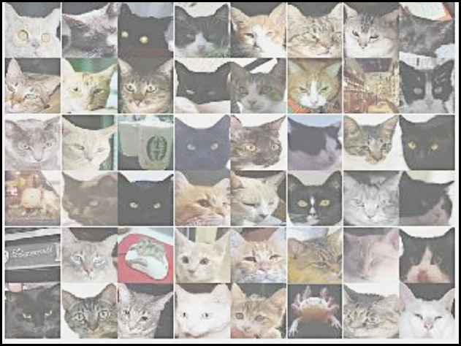
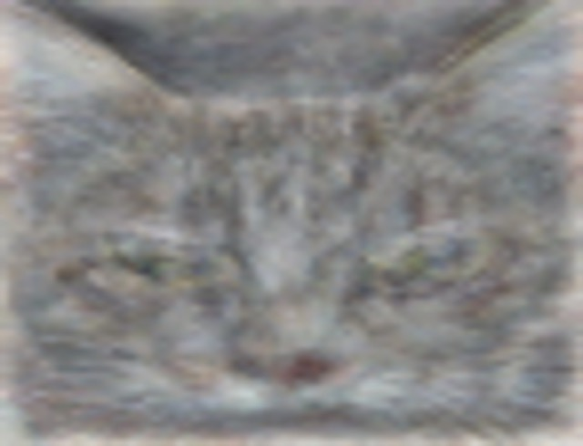
A Neuron That Fires When It Sees Cats
Top stimuli from the test set
Optimal stimulus
by numerical optimization
Le, et al., Building high-level features using large-scale unsupervised learning. ICML 2012

Slide 90





Other Neurons
Neuron 1
Neuron 2
Neuron 3
Neuron 4
Neuron 5
Le, et al., Building high-level features using large-scale unsupervised learning. ICML 2012
Input to another layer above
(image with 8 channels)
Number of output
channels = 8
LCN Size = 5
H
Pooling Size = 5
Number
of maps = 8
One layer
W
RF size = 18
Number of input
channels = 3
Image Size = 200

Slide 91
The Future of AI
Einstein
Human Intelligence
Performance
Complex Programs
Machine Learning
Time
Now
2012
Notes:
NVIDIA or ATI will be future of AI. Probably NVIDIA.

Slide 92
What’s the catch?

Slide 93
(1) Machine Learning Needs Data

Slide 94
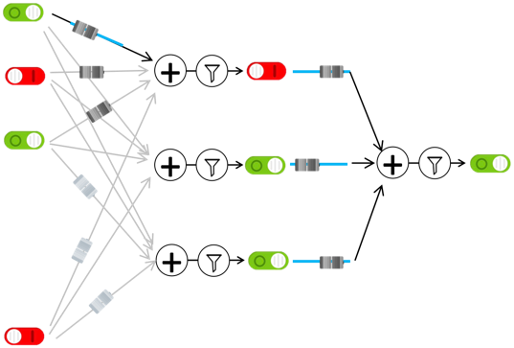
(1) Machine Learning Needs Data
(1) Get Data
(2) Train computer
Compiled by humans
Math and logic

Slide 95
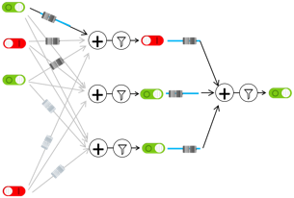
(1) Machine Learning Needs Data
Automatic YouTube captioning
Input: YouTube audio
Output: Captions
(1) Get Data
(2) Train computer
Female speaker error >
Male speaker error
Tatman, Gender and Dialect Bias in YouTube’s Automatic Captions, EthNLP 2017.

Slide 96
(1) Machine Learning Needs Data
Machine Translation
Language
English
(1) Get Data
(2) Train computer
Language | # challenges
German | 7
Czech | 6.5
Russian | 6
Finnish | 5
French,Turkish,Chinese | 3
German-Czech | 1
One-time appearances:
Hindi, Spanish, Lithuanian,
Romanian, Latvian, Estonian, Gujarati
Because the engineers all speak English!
Conference in Machine Translation (WMT), since 2013 http://www.statmt.org/wmt19/
Notes:
Gujarati: Indo-Aryan (India/Pakistan)

Slide 97
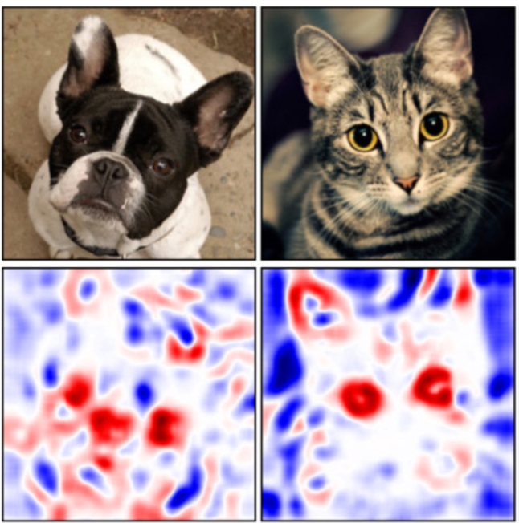
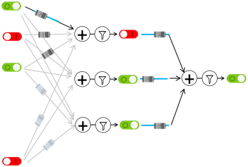
(2) How can we explain decisions?
Visualize sliders
Zintgraf et al., Visualizing Deep Neural Network Decisions: Prediction Difference Analysis, ICLR 2017

Slide 98
(2) How can we explain decisions?
That is a picture of a one!
??
black box
(probably fine)

Slide 99
(2) How can we explain decisions?
This person is dangerous!
??
black box
(not fine)

Slide 100
(3) How can we make it fair?
Should our data reflect society’s systemic bias?
Bolukbasi et al., Man is to Computer Programmer as Woman is to Homemaker? Debiasing Word Embeddings, NIPS 2016
Dataset: Google News

Slide 101






The current challenge
Understand data.
Then train your model.
Then make your system usable for real people.
I can help you better!
Quickly set up the bricks
Spent 2 hrs implementing mouse interactor
Tracy
Instructor

Slide 102
Where is my robot?
… coming soon

Slide 103

You can help
A little math

Slide 104
You can help
Understand; don’t assume

Slide 105
Can you do it?
(I explained to you the main components)
Not easy…
But yes. You can.

Slide 106

Path to AI

Slide 107
Why?

Slide 108

Closest Thing To Magic

Slide 109
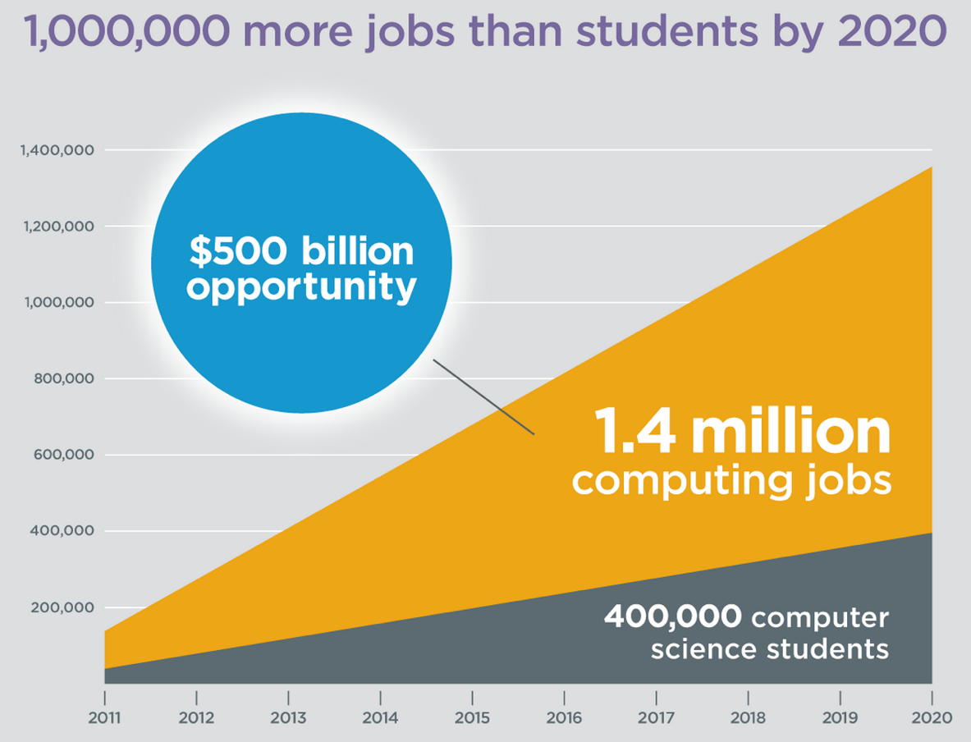
It’s Useful
Code.org

Slide 110
It should fit your culture

Slide 111
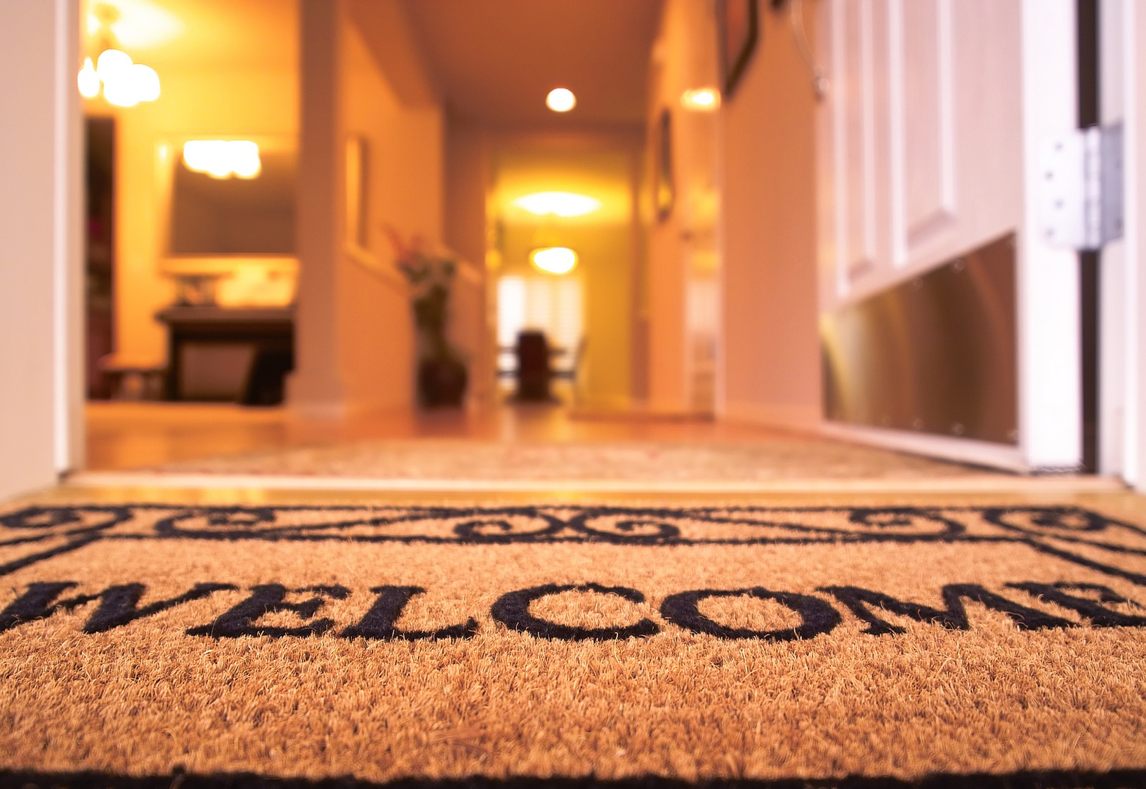
(make it so that) Everyone is Welcome

Slide 112
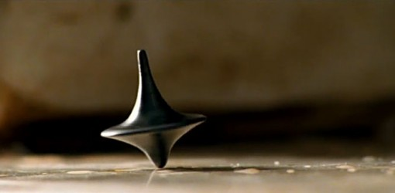
The End?
Submit your projects by 6pm!

